Slide 1
Hibernate One to One Mapping
Various supported techniques for one to one mapping
1. Using foreign key association
2. Using join table
3. @MapsId
One Employee can have only one Account. Similarly, an account will be associated with one employee only. It’s one to one relationship for this example.
Various supported techniques
In hibernate there are 3 ways to create one-to-one relationships between two entities. Either way we have to use @OneToOne annotation.
1) First technique is most widely used and uses a foreign key column in one of the tables.
2) Second technique uses a rather known solution of having a third table to store mapping between first two tables.
3) Third technique is something new which uses a common primary key value in both the tables.

Slide 2
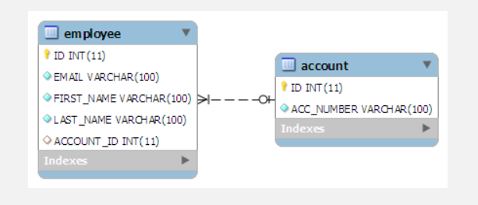
Hibernate one to one mapping with foreign key association
In this kind of association, a foreign key column is created in owner entity. For example, if we make EmployeeEntity owner, then a extra column "ACCOUNT_ID" will be created in Employee table. This column will store the foreign key for Account table.
Table structure will be like this:

Slide 3
Hibernate one to one mapping with foreign key association
In this kind of association, a foreign key column is created in owner entity. For example, if we make EmployeeEntity owner, then a extra column "ACCOUNT_ID" will be created in Employee table. This column will store the foreign key for Account table.
Table structure will be like this:

Slide 4
Hibernate one to one mapping with foreign key association
To make such association, refer the Account entity in EmployeeEntity class as follow:
EmployeeEntity.java
@OneToOne
@JoinColumn(name="ACCOUNT_ID")
private AccountEntity account;
The join column is declared with the @JoinColumn annotation which looks like the @Column annotation. It has one more parameters named referencedColumnName. This parameter declares the column in the targeted entity that will be used to the join.
If no @JoinColumn is declared on the owner side, the defaults apply. A join column(s) will be created in the owner table and its name will be the concatenation of the name of the relationship in the owner side, _ (underscore), and the name of the primary key column(s) in the owned side.
In a bidirectional relationship, one of the sides (and only one) has to be the owner. The owner is responsible for the association column(s) update. To declare a side as not responsible for the relationship, the attribute mappedBy is used. ‘mappedBy’ refers to the property name of the association on the owner side.
AccountEntity.java
@OneToOne(mappedBy="account")
private EmployeeEntity employee;
Above "mappedBy” attribute declares that it is dependent on owner entity for mapping.

Slide 5
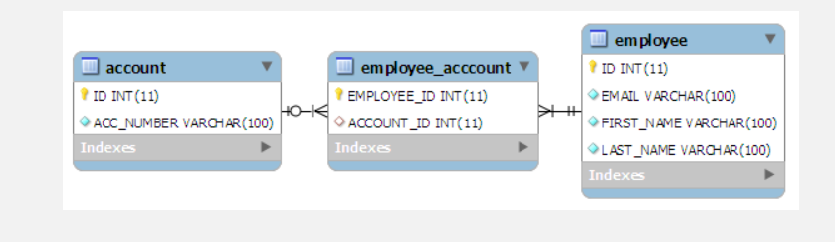
Hibernate one to one mapping with common join table
This approach is not new to all of us. Let us start with targeted DB structure in this technique.

Slide 6
Hibernate one to one mapping with common join table
In this technique, main annotation to be used is @JoinTable. This annotation is used to define the new table name (mandatory) and foreign keys from both of the tables. Lets see how it is used:
EmployeeEntity.java
@OneToOne(cascade = CascadeType.ALL)
@JoinTable(name="EMPLOYEE_ACCCOUNT", joinColumns = @JoinColumn(name="EMPLOYEE_ID"),
inverseJoinColumns = @JoinColumn(name="ACCOUNT_ID"))
private AccountEntity account;
@JoinTable annotation is used in EmployeeEntity class. It declares that a new table EMPLOYEE_ACCOUNT will be created with two columns EMPLOYEE_ID (primary key of EMPLOYEE table) and ACCOUNT_ID (primary key of ACCOUNT table).

Slide 7
Hibernate one to one mapping with @MapsId
In this technique, hibernate assumes both the source and target share the same primary key values.
In this approach, @MapsId is the main annotation to be used. Let see how to use it.
EmployeeEntity.java
@Id
private Integer employeeId;
@OneToOne
@MapsId
private AccountEntity account;
In AccountEntity side, it will remain dependent on the owner entity for the mapping.
AccountEntity.java
@Id
private Integer accountId;

